Slide 1
Database Systems
Lecture 3
Chapter # 6
Basic SQL
Alina Arshad
alina.arshad@nu.edu.pk

Slide 2
Unconditional Oracle INSERT ALL statement(Insert multiple rows into a table)
INSERT ALL
INTO table_name(col1,col2,col3) VALUES(val1,val2, val3)
INTO table_name(col1,col2,col3) VALUES(val4,val5, val6)
INTO table_name(col1,col2,col3) VALUES(val7,val8, val9)
Subquery;

Slide 3
CREATE TABLE fruits (
fruit_name VARCHAR2(100) PRIMARY KEY, color VARCHAR2(100) NOT NULL
);
INSERT ALL
INTO fruits(fruit_name, color) VALUES ('Apple','Red')
INTO fruits(fruit_name, color) VALUES ('Orange','Orange')
INTO fruits(fruit_name, color) VALUES ('Banana','Yellow')
SELECT 1 FROM dual;

Slide 4
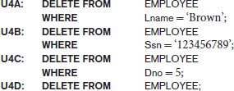
The DELETE Command
DELETE command removes tuples from a relation.

Slide 5

The UPDATE Command
UPDATE command is used to modify attribute values of one or more selected tuples.
Syntax:
UPDATE table_name
SET column1 = value1, column2 = value2, ... WHERE condition;

Slide 6
Update Case
CREATE TABLE project(
project_no CHAR(4) NOT NULL,
project_name CHAR(15) NOT NULL,
budget FLOAT NOT NULL);
insert into project values ('p1', 'Search Engine', 120000.00);
insert into project values ('p2', 'Programming', 95000.00);
insert into project values ('p3', 'SQL', 186500.00);
UPDATE project SET budget = CASE
WHEN budget > 0 and budget < 100000 THEN budget* 1.2
WHEN budget > = 100000 and budget < 200000 THEN budget* 1.1
ELSE budget* 1.05
END;

Slide 7
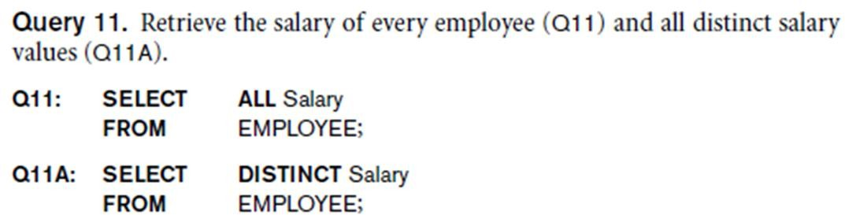
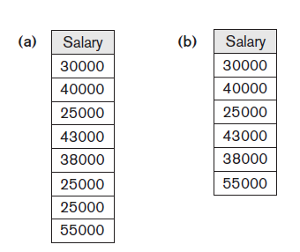
Tables as Sets
Use the keyword DISTINCT in the SELECT clause
To select rows or tuples with distinct values

Slide 8
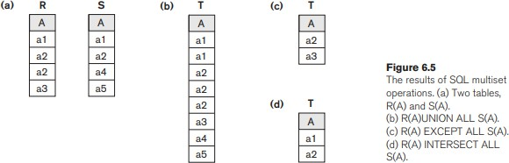
Tables as Sets in SQL
Set operations
UNION, EXCEPT (difference), INTERSECT
Corresponding multiset operations: UNION ALL, EXCEPT ALL, INTERSECT ALL)
Type compatibility is needed for these operations to be valid

Slide 9
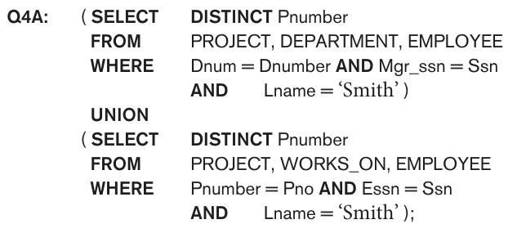

Slide 10
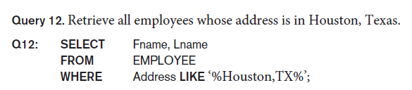
Substring Pattern Matching
LIKE comparison operator: string pattern matching
Partial strings are specified using two reserved characters:
% replaces an arbitrary number of zero or more
characters
underscore (_) replaces a single character.
Examples:

Slide 11
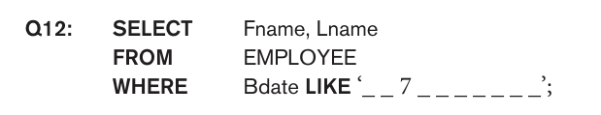
To retrieve all employees who were born during the 1970s, we can use Query Q12.

Slide 12
Substring Pattern Matching
Query 12A. Find all employees who were born during the 1950s.
Q12: SELECT Fname, Lname FROM EMPLOYEE
WHERE Bdate LIKE ‘_ _ 5 _ _ _ _ _ _ _’;

Slide 13
SQL Arithmetic Operators
Query 13. Show the resulting salaries if every employee working on the ‘ProductX’ project is given a 10% raise.
SELECT E.Fname, E.Lname, 1.1 * E.Salary AS Increased_sal
FROM EMPLOYEE E, WORKS_ON W, PROJECT P
WHERE E.Ssn = W.Essn AND W.Pno = P.Pnumber AND
P.Pname = ‘ProductX’;
Operator | Description
+ | Add
- | Subtract
* | Multiply
/ | Divide
% | Modulo

Slide 14
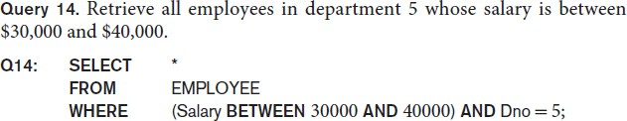
Comparison Operator: Between
BETWEEN: TRUE if the operand is within the range of comparisons
The condition (Salary BETWEEN 30000 AND 40000) in Q14 is equivalent to the condition ((Salary >= 30000) AND (Salary <= 40000)).

Slide 15
Some Other Examples
LIKE Operator | Description
LIKE 'a%' | Finds any values that start with "a"
LIKE '%a' | Finds any values that end with "a"
LIKE '%or%' | Finds any values that have "or" in any position
LIKE '_r%' | Finds any values that have "r" in the second position
LIKE 'a_%' | Finds any values that start with "a" and are at least 2 characters in length
LIKE 'a %' | Finds any values that start with "a" and are at least 3 characters in length
LIKE 'a%o' | Finds any values that start with "a" and ends with "o"

Slide 16

Ordering of Query Results
ORDER BY : order the tuples in the result of a query by the values of one or more of the attributes that appear in the query result.
Syntax:

Slide 17
Sample Database
CustomerID | CustomerName | ContactName | Address | City | PostalCode | Country
1 | Alfreds Futterkiste | Maria Anders | Obere Str. 57 | Berlin | 12209 | Germany
2 | Ana Trujillo Emparedados y helados | Ana Trujillo | Avda. de la Constitución 2222 | México D.F. | 05021 | Mexico
3 | Antonio Moreno Taquería | Antonio Moreno | Mataderos 2312 | México D.F. | 05023 | Mexico
4 | Around the Horn | Thomas Hardy | 120 Hanover Sq. | London | WA1 1DP | UK
5 | Berglunds snabbköp | Christina Berglund | Berguvsvägen 8 | Luleå | S-958 22 | Sweden
6 | Blauer See Delikatessen | Hanna Moos | Forsterstr. 57 | Mannheim | 68306 | Germany
7 | Blondel père et fils | Frédérique Citeaux | 24, place Kléber | Strasbourg | 67000 | France
8 | Bólido Comidas preparadas | Martín Sommer | C/ Araquil, 67 | Madrid | 28023 | Spain

Slide 18

Ordering of Query Results
CustomerID | CustomerName | ContactName | Address | City | PostalCode | Country
12 | Cactus Comidas para llevar | Patricio Simpson | Cerrito 333 | Buenos Aires | 1010 | Argentina
54 | Océano Atlántico Ltda. | Yvonne Moncada | Ing. Gustavo Moncada 8585 Piso 20-A | Buenos Aires | 1010 | Argentina
64 | Rancho grande | Sergio Gutiérrez | Av. del Libertador 900 | Buenos Aires | 1010 | Argentina
20 | Ernst Handel | Roland Mendel | Kirchgasse 6 | Graz | 8010 | Austria
59 | Piccolo und mehr | Georg Pipps | Geislweg 14 | Salzburg | 5020 | Austria
50 | Maison Dewey | Catherine Dewey | Rue Joseph-Bens 532 | Bruxelles | B-1180 | Belgium
76 | Suprêmes délices | Pascale Cartrain | Boulevard Tirou, 255 | Charleroi | B-6000 | Belgium
15 | Comércio Mineiro | Pedro Afonso | Av. dos Lusíadas, 23 | São Paulo | 05432-043 | Brazil

Slide 19
ORDER BY DESC
SELECT * FROM Customers ORDER BY Country DESC;
CustomerID | CustomerName | ContactName | Address | City | PostalCode | Country
33 | GROSELLA-Restaurante | Manuel Pereira | 5ª Ave. Los Palos Grandes | Caracas | 1081 | Venezuela
35 | HILARIÓN-Abastos | Carlos Hernández | Carrera 22 con Ave. Carlos Soublette #8-35 | San Cristóbal | 5022 | Venezuela
46 | LILA-Supermercado | Carlos González | Carrera 52 con Ave. Bolívar #65-98 Llano Largo | Barquisimeto | 3508 | Venezuela
47 | LINO-Delicateses | Felipe Izquierdo | Ave. 5 de Mayo Porlamar | I. de Margarita | 4980 | Venezuela
32 | Great Lakes Food Market | Howard Snyder | 2732 Baker Blvd. | Eugene | 97403 | USA
36 | Hungry Coyote Import Store | Yoshi Latimer | City Center Plaza 516 Main St. | Elgin | 97827 | USA
43 | Lazy K Kountry Store | John Steel | 12 Orchestra Terrace | Walla Walla | 99362 | USA
45 | Let's Stop N Shop | Jaime Yorres | 87 Polk St. Suite 5 | San Francisco | 94117 | USA
48 | Lonesome Pine Restaurant | Fran Wilson | 89 Chiaroscuro Rd. | Portland | 97219 | USA
55 | Old World Delicatessen | Rene Phillips | 2743 Bering St. | Anchorage | 99508 | USA

Slide 20
Any question????

